Slide 1
LWC Training
Testing LWC
MAY 09, 2019
Day 4: Testing LWC

Slide 2
Today’s Objectives
agenda
Introduction to Jest Framework
Setting up the Project
Components Under Test
Hands on Challenge

Slide 3
Introduction to Jest Framework

Slide 4
What is Jest?
Introduction to jest framework
Jest is a JavaScript testing framework created by Facebook.
How is it going to be useful for LWC Testing ?
lwc-jest is Salesforce’s extension of this framework to support testing Lightning Web Components.
lwc-jest made isolating your tests even easier since it allowed you to render a component by itself, call its methods, and interact with its public properties.
This testing framework works from the command line within your IDE and runs entirely on your local machine.
Jest tests work only with Lightning web components, they don’t work with Aura components.
Jest tests aren’t saved to Salesforce and don’t connect to org, so they run faster.

Slide 5
The know-how of Jest Testing
Introduction to jest framework
For anyone with experience of Aura component development, they’ve probably faced the issue of how to test the things! They were so heavily tied to the platform that they couldn’t easily be tested in isolation.
Fortunately, Lightning Web Components has true solution built in from the outset. It’s super simple to write tests and make assertions. Even better, if you’re used to writing tests with Jasmine, Mocha or Jest then you’ll be right at home
Test a component in isolation
Test a component’s public API (@api properties and methods, events)
Test basic user interaction (clicks)
Verify the DOM output of a component
Verify that events fire when expected

Slide 6
Setting up the Project

Slide 7
Setting up the Project
Setting up the project
Prerequisites
To have a sfdx project setup for Lightning web components
GETTING A SALESFORCE ORG
INSTALL THE SALESFORCE DX CLI TOOLS
The CLI tool will help deploy your code to the org. Install it
Installation URL: https://developer.salesforce.com/tools/sfdxcli
INSTALL VISUAL STUDIO CODE
Install the following Extensions
Salesforce Extension Pack
Lightning Web Components
Notes:
ASG – Would need to be ready by Juen for the certified to sell – 3 mo in certified to sell. To show it off at dreamforce 2019.
App exchange I splanned for the solution. If it’s just an asset then they want to review our architecture.
We don’t’ want this on the app exchange.
Approval is all of us, Chandu,. He delegated Subhojit to be our architect.
LWC v Aura – need to be able to regenerate the components with a future technology if needed. Kiran, is the look and feel different, how would that be done?
Security is not yet future proof
Vivek – security team – AERS design
Could we add Louisiana in the mix, to design not to break it in the future – master mapping exercise in the govCONNECT model – if you’re a state with x, here is how you would map to our roles
Let’s make conscious decisions together.
CO – you configure the call, and ti calls an interface, and the framework handles how to call the interface and the elments that are prepopulated.

Slide 8
Setting up the Project
Setting up the project
The first step is to install Node.js and NPM.
Node.js :- 10.15.3(LTS) - https://nodejs.org/en/
node-v9.11.2-x64 - https://nodejs.org/dist/latest-v9.x/ (For Windows users, 64 bit)
Adding project.json file to the root of your project
>npm init
Install Jest and Salesforce LWC Jest integrations with just one simple command :
Notes:
ASG – Would need to be ready by Juen for the certified to sell – 3 mo in certified to sell. To show it off at dreamforce 2019.
App exchange I splanned for the solution. If it’s just an asset then they want to review our architecture.
We don’t’ want this on the app exchange.
Approval is all of us, Chandu,. He delegated Subhojit to be our architect.
LWC v Aura – need to be able to regenerate the components with a future technology if needed. Kiran, is the look and feel different, how would that be done?
Security is not yet future proof
Vivek – security team – AERS design
Could we add Louisiana in the mix, to design not to break it in the future – master mapping exercise in the govCONNECT model – if you’re a state with x, here is how you would map to our roles
Let’s make conscious decisions together.
CO – you configure the call, and ti calls an interface, and the framework handles how to call the interface and the elments that are prepopulated.

Slide 9
Points to ponder while writing Jest Tests
Setting up the project
import { createElement } from 'lwc’;
Imports the createElement function from the
lwc framework
import HelloComponent from 'c/helloComponent’;
Importing our component which we want to
test by convention <namespace>/<moduleName>
describe('c-hello-component', () => {
afterEach(() => {
while (document.body.firstChild) {document.
body.removeChild(document.body.firstChild);}});
Resetting the DOM after every test so that each
test’s output doesn’t affect any other test.
Notes:
ASG – Would need to be ready by Juen for the certified to sell – 3 mo in certified to sell. To show it off at dreamforce 2019.
App exchange I splanned for the solution. If it’s just an asset then they want to review our architecture.
We don’t’ want this on the app exchange.
Approval is all of us, Chandu,. He delegated Subhojit to be our architect.
LWC v Aura – need to be able to regenerate the components with a future technology if needed. Kiran, is the look and feel different, how would that be done?
Security is not yet future proof
Vivek – security team – AERS design
Could we add Louisiana in the mix, to design not to break it in the future – master mapping exercise in the govCONNECT model – if you’re a state with x, here is how you would map to our roles
Let’s make conscious decisions together.
CO – you configure the call, and ti calls an interface, and the framework handles how to call the interface and the elments that are prepopulated.

Slide 10
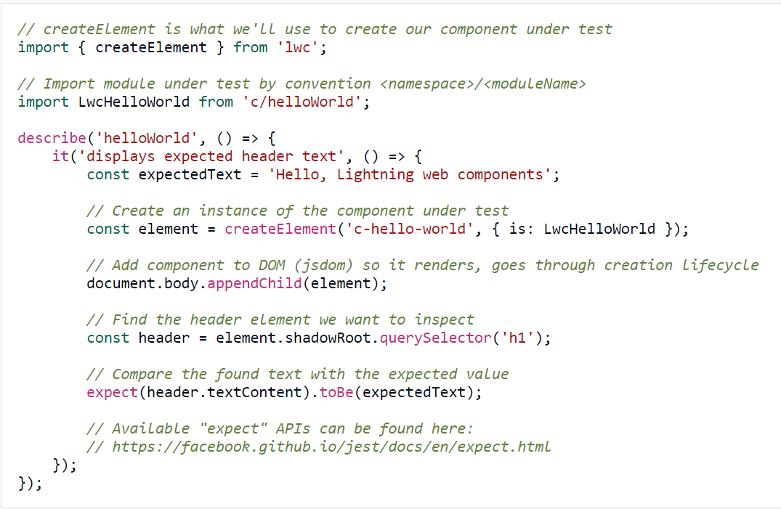
Jest Test Example
Setting up the project
Notes:
ASG – Would need to be ready by Juen for the certified to sell – 3 mo in certified to sell. To show it off at dreamforce 2019.
App exchange I splanned for the solution. If it’s just an asset then they want to review our architecture.
We don’t’ want this on the app exchange.
Approval is all of us, Chandu,. He delegated Subhojit to be our architect.
LWC v Aura – need to be able to regenerate the components with a future technology if needed. Kiran, is the look and feel different, how would that be done?
Security is not yet future proof
Vivek – security team – AERS design
Could we add Louisiana in the mix, to design not to break it in the future – master mapping exercise in the govCONNECT model – if you’re a state with x, here is how you would map to our roles
Let’s make conscious decisions together.
CO – you configure the call, and ti calls an interface, and the framework handles how to call the interface and the elments that are prepopulated.

Slide 11
Jest Test Example (Contd.)
Setting up the project
describe('Renders with Hello World', () => {const element = createElement('c-hello-component', {
is: HelloComponent,});
document.body.appendChild(element);
const pTag = element.shadowRoot.querySelector('p’);
expect(pTag.textContent).toEqual('Hello, World!’);
});
createElement from the lwc will turn our HelloComponent into real DOM element and inserts into body of the page.
expect statement is an assertion of two success conditions: (1) that the expected element was indeed found, and (2) that the found element has an expected style class associated with it.
Notes:
ASG – Would need to be ready by Juen for the certified to sell – 3 mo in certified to sell. To show it off at dreamforce 2019.
App exchange I splanned for the solution. If it’s just an asset then they want to review our architecture.
We don’t’ want this on the app exchange.
Approval is all of us, Chandu,. He delegated Subhojit to be our architect.
LWC v Aura – need to be able to regenerate the components with a future technology if needed. Kiran, is the look and feel different, how would that be done?
Security is not yet future proof
Vivek – security team – AERS design
Could we add Louisiana in the mix, to design not to break it in the future – master mapping exercise in the govCONNECT model – if you’re a state with x, here is how you would map to our roles
Let’s make conscious decisions together.
CO – you configure the call, and ti calls an interface, and the framework handles how to call the interface and the elments that are prepopulated.

Slide 12
Components under Test

Slide 13
JavaScript files in Lightning web components are ES6 modules
Components under test
To test how these components handle data and errors from the wire service, use the:
@salesforce/wire-service-jest-util test utility.
To use the wire service test utility, complete these high-level steps.
In your component bundle, create a folder called __tests__ and a JavaScript class called componentName.test.js. It’s a best practice to name the file after the component, followed by .test.js.
In the componentName.test.js file:
Import the component under test and its wire adapter.
Import registerLdsTestWireAdapter(wireAdapter) from @salesforce/wire-service-jest-util.
Import the mock data from the JSON file.
Register the test wire adapter.
Emit the mock data.
Verify that the component received the mock data.
In the __tests__ folder, create a data folder, and a JSON file called wireAdapter.json. It’s a best practice to name the file after the wire adapter. Mock the data the component expects from
Notes:
ASG – Would need to be ready by Juen for the certified to sell – 3 mo in certified to sell. To show it off at dreamforce 2019.
App exchange I splanned for the solution. If it’s just an asset then they want to review our architecture.
We don’t’ want this on the app exchange.
Approval is all of us, Chandu,. He delegated Subhojit to be our architect.
LWC v Aura – need to be able to regenerate the components with a future technology if needed. Kiran, is the look and feel different, how would that be done?
Security is not yet future proof
Vivek – security team – AERS design
Could we add Louisiana in the mix, to design not to break it in the future – master mapping exercise in the govCONNECT model – if you’re a state with x, here is how you would map to our roles
Let’s make conscious decisions together.
CO – you configure the call, and ti calls an interface, and the framework handles how to call the interface and the elments that are prepopulated.

Slide 14
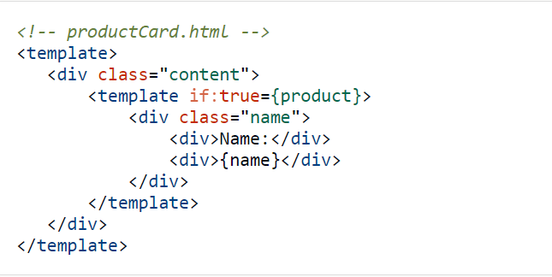
Component under Test
Components under test
The product card component displays a product and its name.
Notes:
ASG – Would need to be ready by Juen for the certified to sell – 3 mo in certified to sell. To show it off at dreamforce 2019.
App exchange I splanned for the solution. If it’s just an asset then they want to review our architecture.
We don’t’ want this on the app exchange.
Approval is all of us, Chandu,. He delegated Subhojit to be our architect.
LWC v Aura – need to be able to regenerate the components with a future technology if needed. Kiran, is the look and feel different, how would that be done?
Security is not yet future proof
Vivek – security team – AERS design
Could we add Louisiana in the mix, to design not to break it in the future – master mapping exercise in the govCONNECT model – if you’re a state with x, here is how you would map to our roles
Let’s make conscious decisions together.
CO – you configure the call, and ti calls an interface, and the framework handles how to call the interface and the elments that are prepopulated.

Slide 15
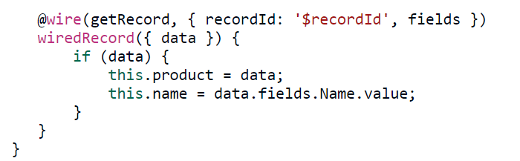
Component under Test (Contd.)
Components under test
The JavaScript file, the @wire decorator tells the wire service to use the getRecord wire adapter to provision record data.
Notes:
ASG – Would need to be ready by Juen for the certified to sell – 3 mo in certified to sell. To show it off at dreamforce 2019.
App exchange I splanned for the solution. If it’s just an asset then they want to review our architecture.
We don’t’ want this on the app exchange.
Approval is all of us, Chandu,. He delegated Subhojit to be our architect.
LWC v Aura – need to be able to regenerate the components with a future technology if needed. Kiran, is the look and feel different, how would that be done?
Security is not yet future proof
Vivek – security team – AERS design
Could we add Louisiana in the mix, to design not to break it in the future – master mapping exercise in the govCONNECT model – if you’re a state with x, here is how you would map to our roles
Let’s make conscious decisions together.
CO – you configure the call, and ti calls an interface, and the framework handles how to call the interface and the elments that are prepopulated.

Slide 16
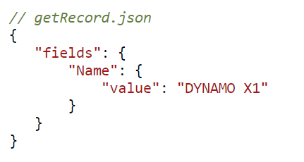
Mock Data
Components under test
In your __tests__ folder, create a folder called data. Within the data folder, make a file called getRecord.json, the same name as the wire adapter. Define the data that the component expects from the server..
Notes:
ASG – Would need to be ready by Juen for the certified to sell – 3 mo in certified to sell. To show it off at dreamforce 2019.
App exchange I splanned for the solution. If it’s just an asset then they want to review our architecture.
We don’t’ want this on the app exchange.
Approval is all of us, Chandu,. He delegated Subhojit to be our architect.
LWC v Aura – need to be able to regenerate the components with a future technology if needed. Kiran, is the look and feel different, how would that be done?
Security is not yet future proof
Vivek – security team – AERS design
Could we add Louisiana in the mix, to design not to break it in the future – master mapping exercise in the govCONNECT model – if you’re a state with x, here is how you would map to our roles
Let’s make conscious decisions together.
CO – you configure the call, and ti calls an interface, and the framework handles how to call the interface and the elments that are prepopulated.

Slide 17
Run Tests For Lightning Web Component
Components under test
Run Tests on the Command Line
In order to run all tests for your project, run the command
which you have added to the scripts block of your
package.json file:-
npm run test:unit
Run Tests Continuously During Development
To run all tests for a single component every time you
save changes, change directories to the component
directory, and run the command you added to the scripts
block of your project’s package.json file with the --watch parameter.
npm run test:unit -- --watch
Notes:
ASG – Would need to be ready by Juen for the certified to sell – 3 mo in certified to sell. To show it off at dreamforce 2019.
App exchange I splanned for the solution. If it’s just an asset then they want to review our architecture.
We don’t’ want this on the app exchange.
Approval is all of us, Chandu,. He delegated Subhojit to be our architect.
LWC v Aura – need to be able to regenerate the components with a future technology if needed. Kiran, is the look and feel different, how would that be done?
Security is not yet future proof
Vivek – security team – AERS design
Could we add Louisiana in the mix, to design not to break it in the future – master mapping exercise in the govCONNECT model – if you’re a state with x, here is how you would map to our roles
Let’s make conscious decisions together.
CO – you configure the call, and ti calls an interface, and the framework handles how to call the interface and the elments that are prepopulated.

Slide 18
Hands on Challenge

Slide 19
Step by step Testing LWC
Hands on challenge
Assuming that you already have a SFDX project setup on your machine .
Firstly ,we will add a project.json file to the root of our project . If there is no project.json , use npm-init and default all the steps .
Now , lets install Jest testing framework for LWC by using the below command :
Notes:
ASG – Would need to be ready by Juen for the certified to sell – 3 mo in certified to sell. To show it off at dreamforce 2019.
App exchange I splanned for the solution. If it’s just an asset then they want to review our architecture.
We don’t’ want this on the app exchange.
Approval is all of us, Chandu,. He delegated Subhojit to be our architect.
LWC v Aura – need to be able to regenerate the components with a future technology if needed. Kiran, is the look and feel different, how would that be done?
Security is not yet future proof
Vivek – security team – AERS design
Could we add Louisiana in the mix, to design not to break it in the future – master mapping exercise in the govCONNECT model – if you’re a state with x, here is how you would map to our roles
Let’s make conscious decisions together.
CO – you configure the call, and ti calls an interface, and the framework handles how to call the interface and the elments that are prepopulated.

Slide 20
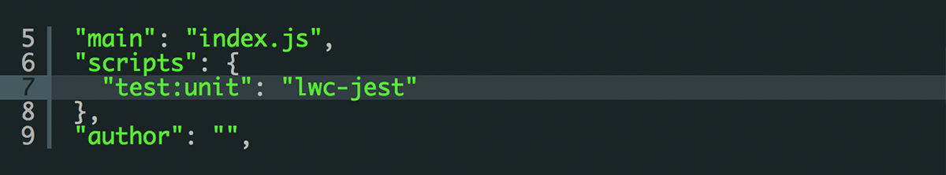
Update your package.json
Hands on challenge
Now when you run npm run test:unit it will run the lwc-jest cli command which in turn, will call jest.
Notes:
ASG – Would need to be ready by Juen for the certified to sell – 3 mo in certified to sell. To show it off at dreamforce 2019.
App exchange I splanned for the solution. If it’s just an asset then they want to review our architecture.
We don’t’ want this on the app exchange.
Approval is all of us, Chandu,. He delegated Subhojit to be our architect.
LWC v Aura – need to be able to regenerate the components with a future technology if needed. Kiran, is the look and feel different, how would that be done?
Security is not yet future proof
Vivek – security team – AERS design
Could we add Louisiana in the mix, to design not to break it in the future – master mapping exercise in the govCONNECT model – if you’re a state with x, here is how you would map to our roles
Let’s make conscious decisions together.
CO – you configure the call, and ti calls an interface, and the framework handles how to call the interface and the elments that are prepopulated.

Slide 21
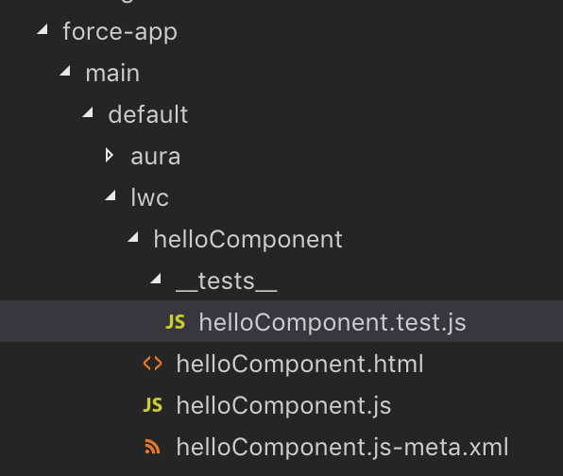
Adding a test to an LWC Component
Hands on challenge
Add a folder called __tests__ and a file under it called hellocomponent.test.js
Notes:
ASG – Would need to be ready by Juen for the certified to sell – 3 mo in certified to sell. To show it off at dreamforce 2019.
App exchange I splanned for the solution. If it’s just an asset then they want to review our architecture.
We don’t’ want this on the app exchange.
Approval is all of us, Chandu,. He delegated Subhojit to be our architect.
LWC v Aura – need to be able to regenerate the components with a future technology if needed. Kiran, is the look and feel different, how would that be done?
Security is not yet future proof
Vivek – security team – AERS design
Could we add Louisiana in the mix, to design not to break it in the future – master mapping exercise in the govCONNECT model – if you’re a state with x, here is how you would map to our roles
Let’s make conscious decisions together.
CO – you configure the call, and ti calls an interface, and the framework handles how to call the interface and the elments that are prepopulated.

Slide 22
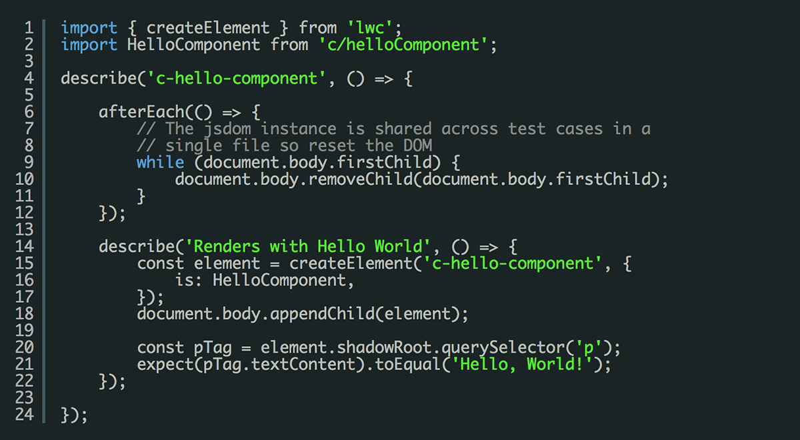
Inside this file we’ll add our first test
Hands on challenge
Notes:
ASG – Would need to be ready by Juen for the certified to sell – 3 mo in certified to sell. To show it off at dreamforce 2019.
App exchange I splanned for the solution. If it’s just an asset then they want to review our architecture.
We don’t’ want this on the app exchange.
Approval is all of us, Chandu,. He delegated Subhojit to be our architect.
LWC v Aura – need to be able to regenerate the components with a future technology if needed. Kiran, is the look and feel different, how would that be done?
Security is not yet future proof
Vivek – security team – AERS design
Could we add Louisiana in the mix, to design not to break it in the future – master mapping exercise in the govCONNECT model – if you’re a state with x, here is how you would map to our roles
Let’s make conscious decisions together.
CO – you configure the call, and ti calls an interface, and the framework handles how to call the interface and the elments that are prepopulated.

Slide 23
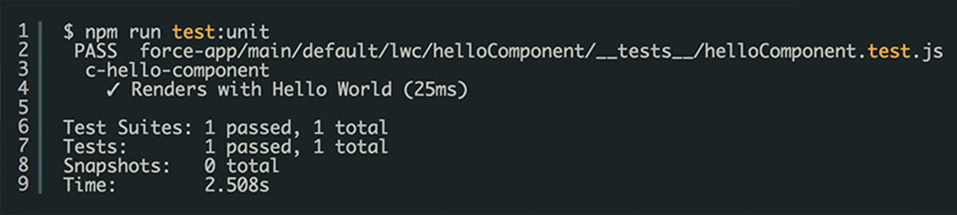
finally we run our assertion – in this case , should be a tag whose text content is Hello, World
Hands on challenge
Run the below command :
npm run test:unit
Notes:
ASG – Would need to be ready by Juen for the certified to sell – 3 mo in certified to sell. To show it off at dreamforce 2019.
App exchange I splanned for the solution. If it’s just an asset then they want to review our architecture.
We don’t’ want this on the app exchange.
Approval is all of us, Chandu,. He delegated Subhojit to be our architect.
LWC v Aura – need to be able to regenerate the components with a future technology if needed. Kiran, is the look and feel different, how would that be done?
Security is not yet future proof
Vivek – security team – AERS design
Could we add Louisiana in the mix, to design not to break it in the future – master mapping exercise in the govCONNECT model – if you’re a state with x, here is how you would map to our roles
Let’s make conscious decisions together.
CO – you configure the call, and ti calls an interface, and the framework handles how to call the interface and the elments that are prepopulated.

Slide 24
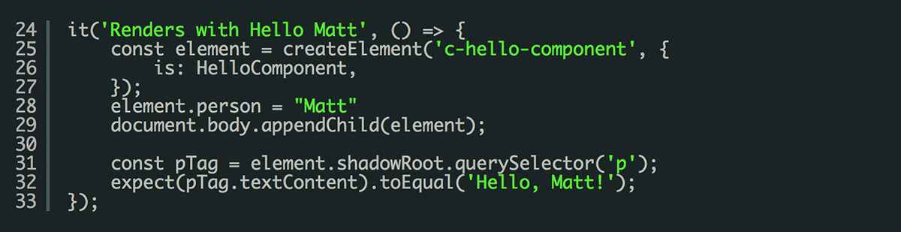
Testing a Property Change
Hands on challenge
Whilst a passing test is nice, it’s not really covering all our logic. One thing we should do is verify that if we set the person property to a different value, then that value is reflected in the DOM too. Let’s add a new test for that. After your existing test add the following.
Notes:
ASG – Would need to be ready by Juen for the certified to sell – 3 mo in certified to sell. To show it off at dreamforce 2019.
App exchange I splanned for the solution. If it’s just an asset then they want to review our architecture.
We don’t’ want this on the app exchange.
Approval is all of us, Chandu,. He delegated Subhojit to be our architect.
LWC v Aura – need to be able to regenerate the components with a future technology if needed. Kiran, is the look and feel different, how would that be done?
Security is not yet future proof
Vivek – security team – AERS design
Could we add Louisiana in the mix, to design not to break it in the future – master mapping exercise in the govCONNECT model – if you’re a state with x, here is how you would map to our roles
Let’s make conscious decisions together.
CO – you configure the call, and ti calls an interface, and the framework handles how to call the interface and the elments that are prepopulated.

Slide 25
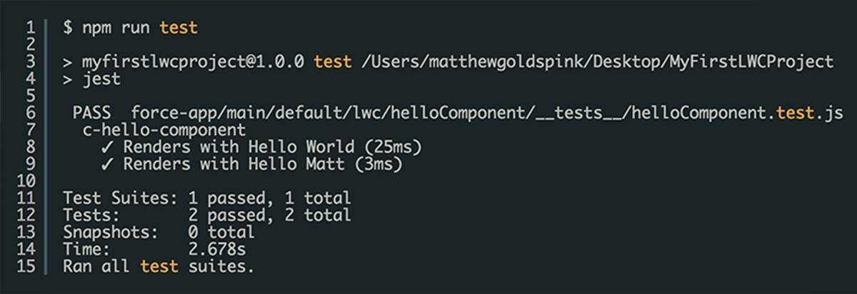
Run the Unit Test now
Hands on challenge
Notes:
ASG – Would need to be ready by Juen for the certified to sell – 3 mo in certified to sell. To show it off at dreamforce 2019.
App exchange I splanned for the solution. If it’s just an asset then they want to review our architecture.
We don’t’ want this on the app exchange.
Approval is all of us, Chandu,. He delegated Subhojit to be our architect.
LWC v Aura – need to be able to regenerate the components with a future technology if needed. Kiran, is the look and feel different, how would that be done?
Security is not yet future proof
Vivek – security team – AERS design
Could we add Louisiana in the mix, to design not to break it in the future – master mapping exercise in the govCONNECT model – if you’re a state with x, here is how you would map to our roles
Let’s make conscious decisions together.
CO – you configure the call, and ti calls an interface, and the framework handles how to call the interface and the elments that are prepopulated.

Slide 26
Code is available as GitHub project
Hands on challenge
In Case of any blockers while working with the hands on challenge, code is available as a GitHub project for you to clone
and run: bit.ly/2tcSHKq
Notes:
ASG – Would need to be ready by Juen for the certified to sell – 3 mo in certified to sell. To show it off at dreamforce 2019.
App exchange I splanned for the solution. If it’s just an asset then they want to review our architecture.
We don’t’ want this on the app exchange.
Approval is all of us, Chandu,. He delegated Subhojit to be our architect.
LWC v Aura – need to be able to regenerate the components with a future technology if needed. Kiran, is the look and feel different, how would that be done?
Security is not yet future proof
Vivek – security team – AERS design
Could we add Louisiana in the mix, to design not to break it in the future – master mapping exercise in the govCONNECT model – if you’re a state with x, here is how you would map to our roles
Let’s make conscious decisions together.
CO – you configure the call, and ti calls an interface, and the framework handles how to call the interface and the elments that are prepopulated.

Slide 27
Resources
Hands on challenge
Salesforce Developer Guide – Test Lightning Web Components
Example Jest tests in Ebikes
Jest Documentation
https://vlocity.com/community/testing-lightning-web-components
Notes:
ASG – Would need to be ready by Juen for the certified to sell – 3 mo in certified to sell. To show it off at dreamforce 2019.
App exchange I splanned for the solution. If it’s just an asset then they want to review our architecture.
We don’t’ want this on the app exchange.
Approval is all of us, Chandu,. He delegated Subhojit to be our architect.
LWC v Aura – need to be able to regenerate the components with a future technology if needed. Kiran, is the look and feel different, how would that be done?
Security is not yet future proof
Vivek – security team – AERS design
Could we add Louisiana in the mix, to design not to break it in the future – master mapping exercise in the govCONNECT model – if you’re a state with x, here is how you would map to our roles
Let’s make conscious decisions together.
CO – you configure the call, and ti calls an interface, and the framework handles how to call the interface and the elments that are prepopulated.

